Slide 1

Introduction to Database
Your success is our success
Part 01 - Database Design lifecycle
Funny Gorilla 诙猩猩
Notes:
Notes for title slide

Slide 2



转IT， 2个月， 拿 offer
明确目标 ， 界定范围
有目标感，scope, 全力以赴
专注于一种职业， 技术方向
不要同时追两只兔子
快速进入找工作循环， 持续反馈， 修正
不要闭门造车
拿到offer以前的尝试，都是不断进步， 不是失败
有成长思维，
在找工作中中学习找工作
Notes:
专注带来效率，excellence.
见过很多刚刚毕业的学生， 毕业两年之后还是没有章法
找工作遵循水桶理论 – 发现短板， 集中精力解决问题
拯救全人类的理想， 等你找到工作， 填报肚皮再考虑； 或者在救火的时候， 就不要练气功了
找工作是一项技能，需要不断锤炼： 你只要一份工作， 前面所有的面试努力都是为下一次成功打下基础

Slide 3
Learning Objectives
By the end of this learning module, you will be able to understand and practice:
Database lifecycle
Entity relationship model

Slide 4
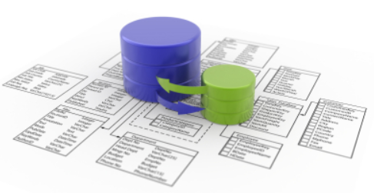
Database Concept
Why?

Slide 5
Why?
Data redundancy and inconsistency
Difficulty in accessing data
Data isolation
Integrity problems
Atomicity problems
Concurrent-access anomalies
Security problems

Slide 6
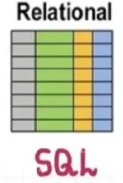
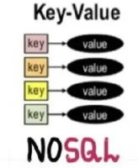

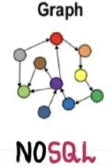
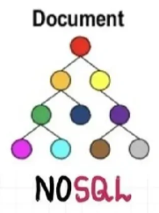




Database Types

Slide 7
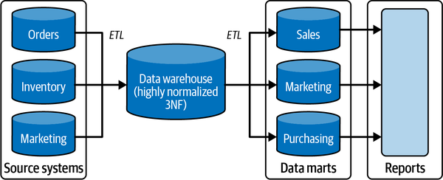
Data Landscape

Slide 8
Relational Database Lifecycle
Conceptual Design
1
Logical Design
2
Physical Design
3
Implementation
4

Slide 9
Entity Relationship Data Modeling
business entities
attributes
relationship
Cardinality & ordinality

Slide 10
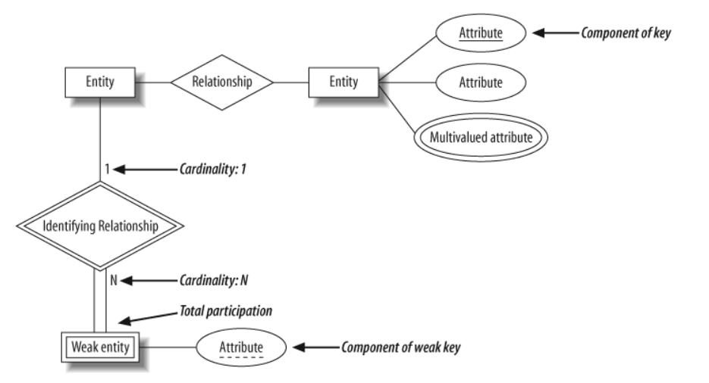
ER Data Modeling

Slide 11
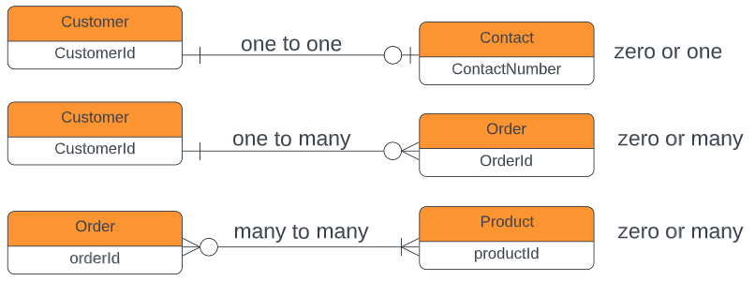
ER Data Modeling - cardinality
one
many
exactly one
zero or many
zero or one
one or many

Slide 12
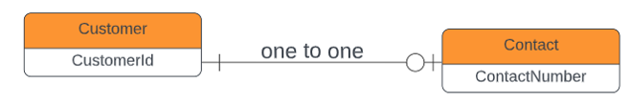


ER Data Modeling - cardinality

Slide 13
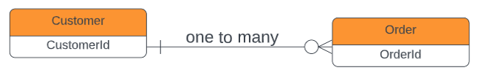


ER Data Modeling - cardinality

Slide 14




ER Data Modeling - cardinality

Slide 15


Conceptual Design - ERD
Conceptual Design
Logical Design
Physical Design
Implementation
1
2
3
4

Slide 16
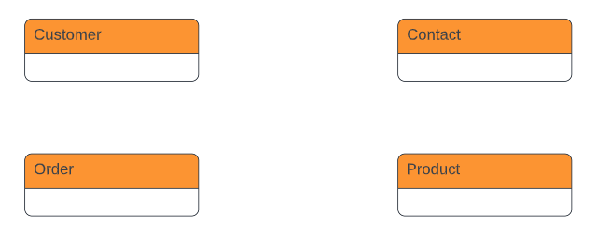
has a
place
contains

Slide 17

Logical Design - ERD
Conceptual Design
Logical Design
Physical Design
Implementation
1
2
3
4
Find attributes for each entity
Specify cardinality for relationship

Slide 18
Conceptual Design
Logical Design
Physical Design
Implementation
1
2
3
4
Normalization
Denormalization

Slide 19

First normal form (1NF)
Each column is unique and has a single value. The table has a unique primary key.
Second normal form (2NF)
The requirements of 1NF, plus partial dependencies are removed.
Third normal form (3NF)
The requirements of 2NF, plus each table contains only relevant fields related to its primary key and has no transitive dependencies.

Slide 20
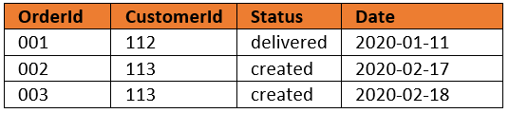
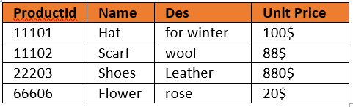

Conceptual Design
Logical Design
Physical Design
Implementation
1
2
3
4
How to store this m-2-m relationship in tables?

Slide 21
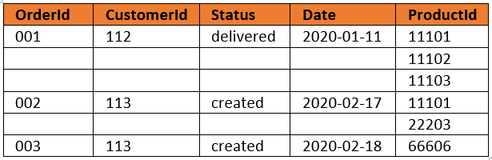
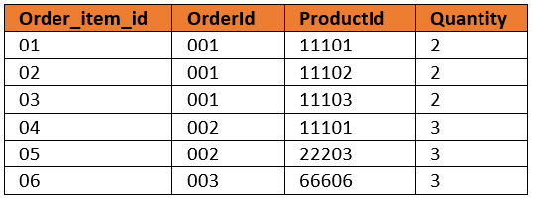
Conceptual Design
Logical Design
Physical Design
Implementation
1
2
3
4

Slide 22
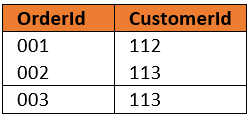
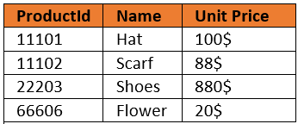
Conceptual Design
Logical Design
Physical Design
Implementation
1
2
3
4
M:M => a pair of 1:M

Slide 23
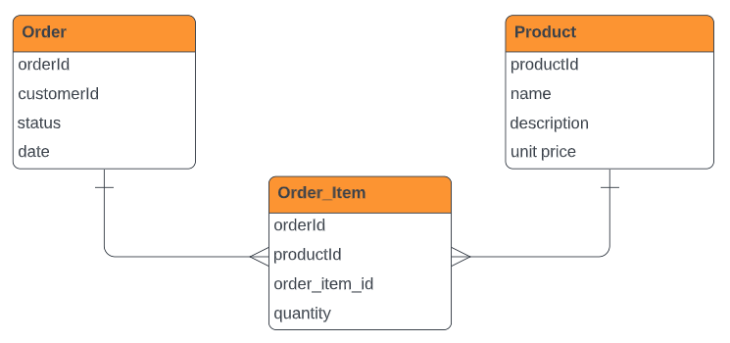
Conceptual Design
Logical Design
Physical Design
Implementation
1
2
3
4

Slide 24
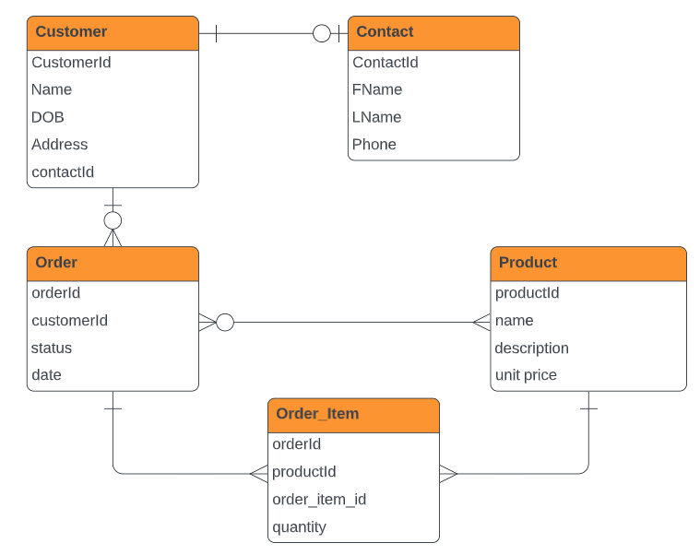
Conceptual Design
Logical Design
Physical Design
Implementation
1
2
3
4
Column (attributes) are defined
A new entity is added to mode each individual items

Slide 25
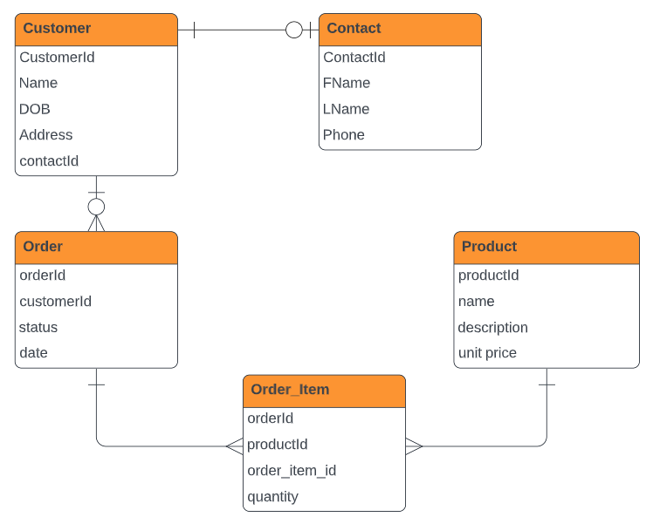
Conceptual Design
Logical Design
Physical Design
Implementation
1
2
3
4
Column (attributes) are defined
A new entity is added to mode each individual items

Slide 26


Physical Design - ERD
Conceptual Design
Logical Design
Physical Design
Implementation
1
2
3
4

Slide 27
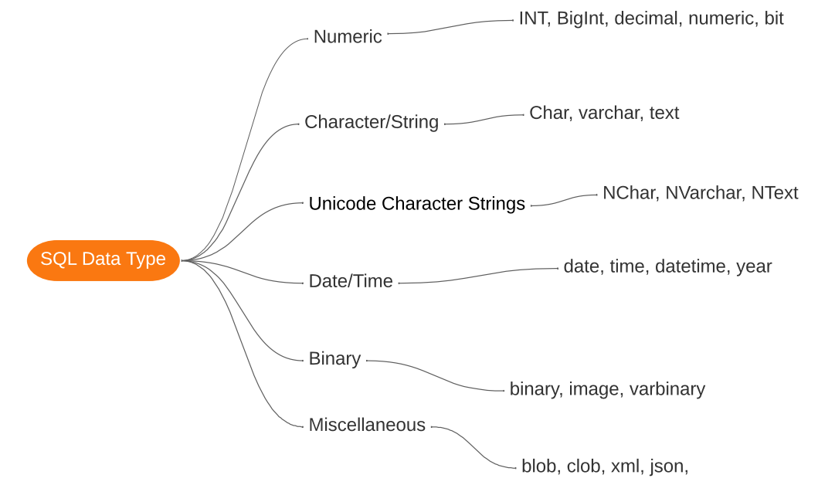
ER Data Modeling
- Define types

Slide 28

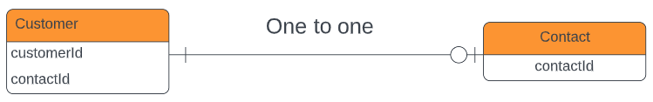


ER Data Modeling
- Define keys
Foreign key
Primary key

Slide 29

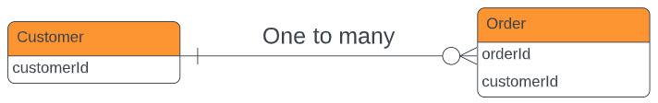


ER Data Modeling
- Define keys
Primary key
Foreign key

Slide 30
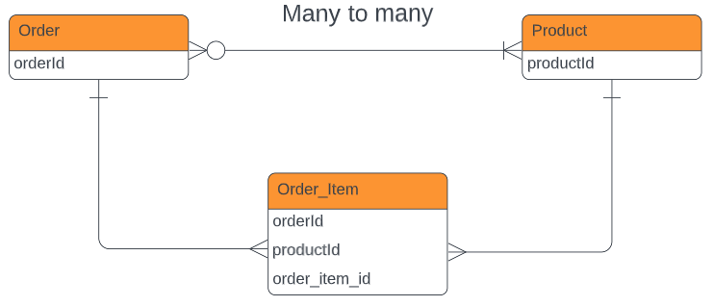


ER Data Modeling
- Define keys
Primary key
Primary key
Foreign key
Foreign key

Slide 31
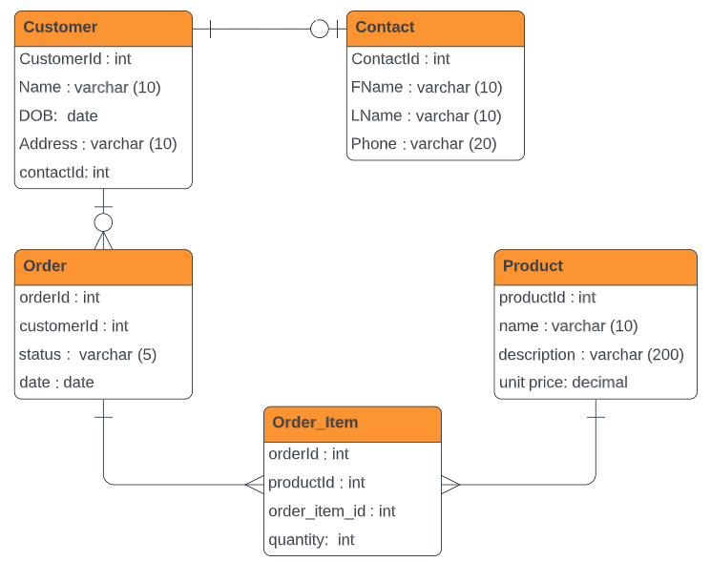
Conceptual Design
Logical Design
Physical Design
Implementation
1
2
3
4
Primary keys are defined for entities
Data types are set for each attributes
Foreign keys are defined for entities
Many-2-many relationship between order and product is converted into a pair of one-many relationships

Slide 32
Case Study
Student is allowed to enroll one course.
Each course includes multiple subjects, with each subject belonging to one course.
Subject score for students are to be persistent.
There is compulsory text book for each subject.

Slide 33
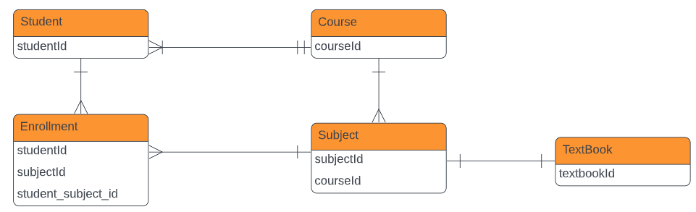

Slide 34
Conceptual Design
Logical Design
Physical Design
Implementation
1
2
3
4
Implementation - SQL

Slide 35
Structured Query Language
SQL is a computer language for Storing, Manipulating and Retrieving data stored in a relational database.
What SQL can do:
Create/drop database
Create/drop tables;
Create, read, update, delete (CRUD) data into tables;
SQL comes with different flavors from different vendors.

Slide 36
Denormalization

Slide 37
Reference Links
https://medium.com/omarelgabrys-blog/database-introduction-part-1-4844fada1fb0

Slide 38

Your success is our success
Contact
Mail: info@funnygorilla.com.au
Linkedin: https://mt.linkedin.com/in/songqing-gu-2ba9034b/de
Web Chat: FunnyGorilla
Phone: 0420891343

